Slide 1
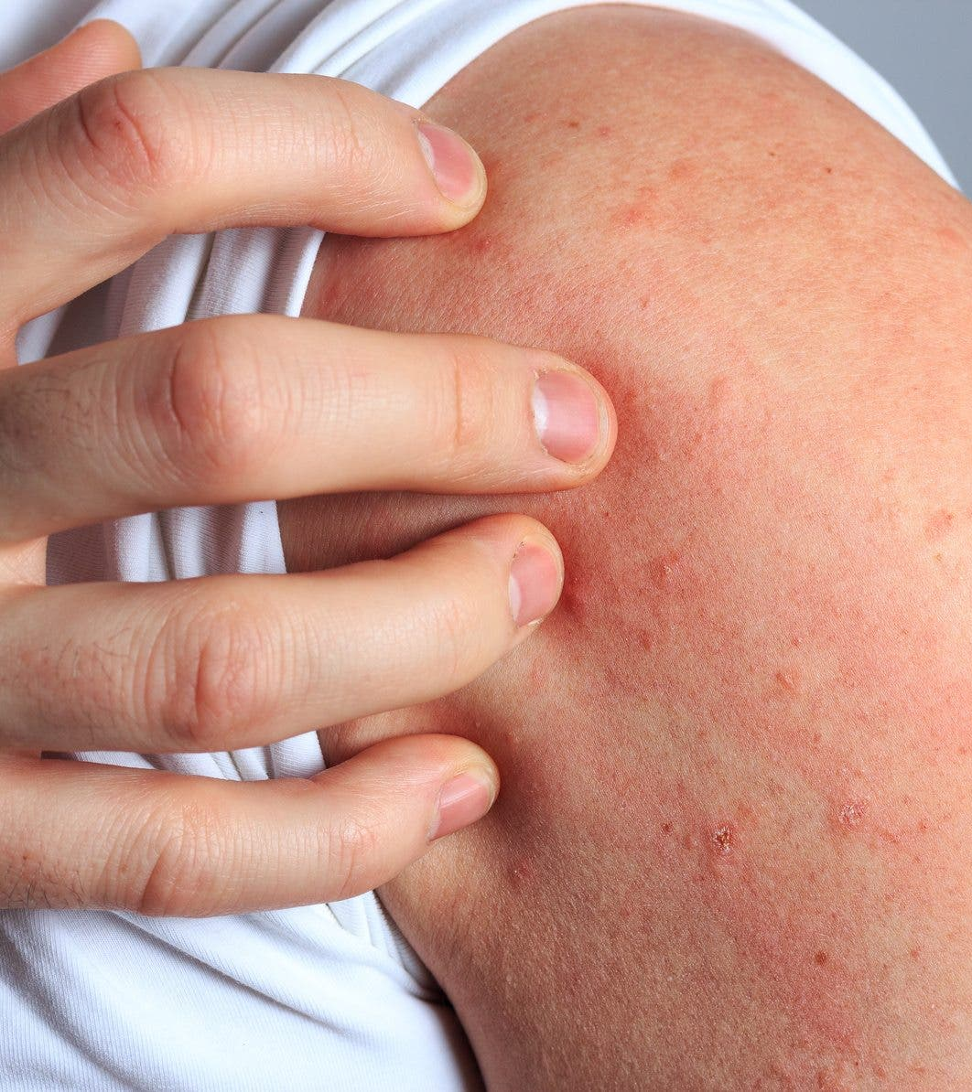
Association of Atopic Dermatitis with Depression & Anxiety
Madhavi Anuradha

Slide 2
CHARACTERS
Atopic dermatitis (AD)
Depression
Anxiety
Brain reward circuit
Mesolimbic pathway
Primed Microglia

Slide 3
Association of Atopic Dermatitis with Depression & Anxiety
How does AD influence development of anxiety- and depressive-like behaviors?
What are the molecular mechanisms involved?
What are the effects of early life period AD in adolescents’ mental health?
Does Isodon inflexus extract (IIE) have potential to alleviate AD and decrease AD-associated depressive-like behavior?

Slide 4
We will discuss……
AD associated changes in the mesolimbic pathway
‘Two-hit’ hypothesis
Microglia priming
Neuroinflammatory responses

Slide 5
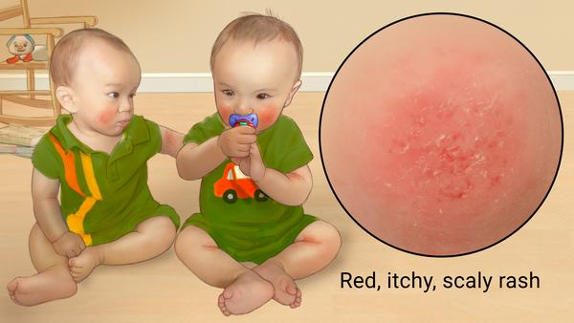
Atopic Dermatitis (AD)
Affects up to 30% of children and up to 17% of adults worldwide
https://www.skincareresearchboca.com/areas-of-research/clinical-dermatology/atopic-dermatitis-eczema/

Slide 6
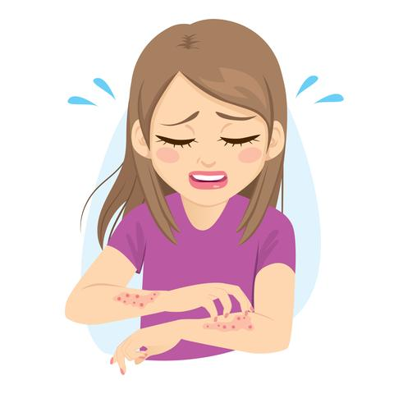
Atopic dermatitis (AD) – Main Symptoms
Dry skin
Lichenification - skin becomes thick and leathery
Erythematous scaling papules
Eczematous inflammation
Persistent intense itching
Abnormal immune responses
IgE-mediated allergies to various exogenous antigens
https://www.mountainside-medical.com/blogs/medical-supplies/all-about-eczema-atopic-dermatitis

Slide 7
Atopic Dermatitis ↔️ Negative Emotional Problems
Depression
Anxiety
Attention-Deficit/Hyperactivity Disorder (ADHD)
Autism
Molecular mechanism that underlies AD-associated emotional impairments

Slide 8
Depression
Loss of interest and enjoyment in ordinary things and experiences
Affects approximately 4.4% of the global population
AD associated depression - 14% increase

Slide 9
Anxiety
Characterized by:
Excessive fear
Anxiousness
Avoidance of perceived threats
Affects approximately 3.6% of the global population
AD associated anxiety diagnosis - 17% increase

Slide 10
Hypothesis
AD promotes Anxiety- and Depressive-like behavior that is associated with neural adaptations in brain reward circuitry
Early life stress from AD aggravates susceptibility to systemic inflammation in the adolescent brain, leading to depressive behaviors

Slide 11
Purpose
Determine the influence of AD on the development of anxiety- and depressive-like behaviors
Investigate whether there are any AD-associated changes in dopamine (DA) signaling in the striatum and Ventral Tegmental Area (VTA)
Determine whether early life stress from allergic dermatitis causes depressive-like behaviors in adolescent mice through neuroinflammatory priming
Investigate the potential effect of IIE in AD and AD-associated depressive-like behavior

Slide 12
Significance
Understanding the relationship between AD and psychological disorders will be beneficial for more effective management of AD and AD-associated
psychological disorders

Slide 13
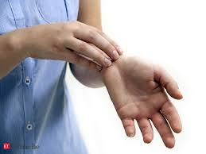
Scratching – providing temporary relief
Scratching evokes a pleasurable feeling – related to the brain's reward system
https://www.skincareresearchboca.com/areas-of-research/clinical-dermatology/atopic-dermatitis-eczema/

Slide 14
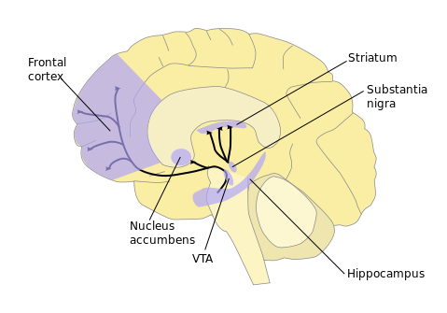
Mesolimbic Pathway
The dopaminergic cells projecting from the Ventral Tegmental Area (VTA) to striatum – key players in the brain reward system
Neurons that release dopamine are activated when we expect to receive a reward.
DA reward circuit – mediates negative emotional states such as anxiety, depression, and stress
Depressive symptoms – reduce activation of the brain's reward circuitry, specifically the Nac
https://www.clipartkey.com/view/bJixJx_brain-motivation-and-reward-system/

Slide 15
Vitamin D3 Analog MC903 Induces Experimental AD-like Symptoms
1. Lesion severity
Days
1 | 2 | 3 | 4 | 5 | 6 | 7 | 8 | 9 | 10 | 11
MC903 Treatment Period |  |  |  |  |  | Post –treatment Period

Slide 16
Vitamin D3 Analog MC903 Induces Experimental AD-like Symptoms
2. Scratching Behavior
Days
1 | 2 | 3 | 4 | 5 | 6 | 7 | 8 | 9 | 10 | 11
MC903 Treatment Period |  |  |  |  |  | Post –treatment Period

Slide 17
Vitamin D3 Analog MC903 Induces Experimental AD-like Symptoms
3. Histological Evaluation
Days
1 | 2 | 3 | 4 | 5 | 6 | 7 | 8 | 9 | 10 | 11
MC903 Treatment Period |  |  |  |  |  | Post –treatment Period

Slide 18
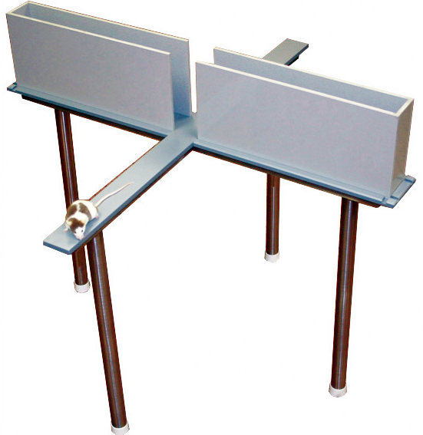
MC903-Induced AD Elicits Anxiety-like Behavior
Elevated plus maze test (EPM)
Days
1 | 2 | 3 | 4 | 5 | 6 | 7 | 8 | 9 | 10 | 11
MC903 Treatment Period |  |  |  |  |  | Post –treatment Period
https://lafayetteneuroscience.com/products/no-auto-elevated-plus-mice

Slide 19
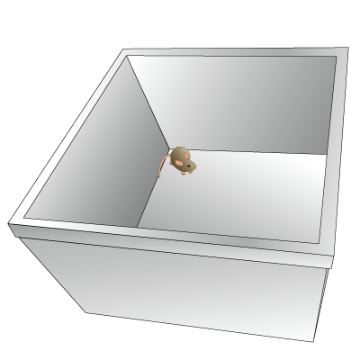
MC903-Induced AD Elicits Anxiety-like Behavior
Open field test (OFT)
Days
1 | 2 | 3 | 4 | 5 | 6 | 7 | 8 | 9 | 10 | 11
MC903 Treatment Period |  |  |  |  |  | Post –treatment Period
https://commons.wikimedia.org/wiki/File:201407_open_field_test.png

Slide 20
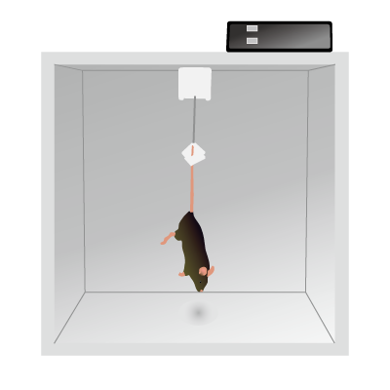
MC903-Induced AD Elicits Depressive-like Behavior
Tail suspension test (TST)
Days
1 | 2 | 3 | 4 | 5 | 6 | 7 | 8 | 9 | 10 | 11
MC903 Treatment Period |  |  |  |  |  | Post –treatment Period
https://en.wikipedia.org/wiki/Tail_suspension_test

Slide 21
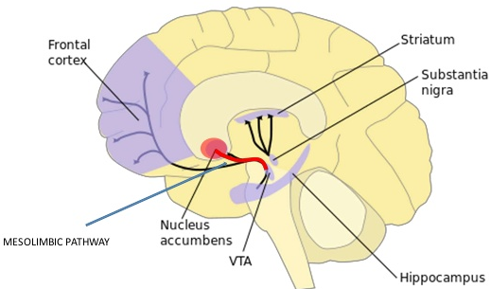
Molecular changes in Mesolimbic Pathway
Striatum
Nucleus Accumbens (Nac)
Dorsal Striatum (DS)
Ventral Tegmental Area (VTA)

Slide 22
MC903-induced AD alters neuronal plasticity and DA-related molecules in the mesolimbic system
Nucleus Accumbens (NAc)
Dorsal Striatum (DS)
Ventral Tegmental Area (VTA)
Dopamine D1 receptor - D1AR
phospho-Thr34 DARPP32 - pDARPP32
Tyrosine hydroxylase - TH
Notes:
Western blot

Slide 23
MC903-induced AD alters neuronal plasticity and DA-related molecules in the mesolimbic system
Nucleus Accumbens (NAc)
Dorsal Striatum (DS)
Ventral Tegmental Area (VTA)
Notes:
Western blot

Slide 24
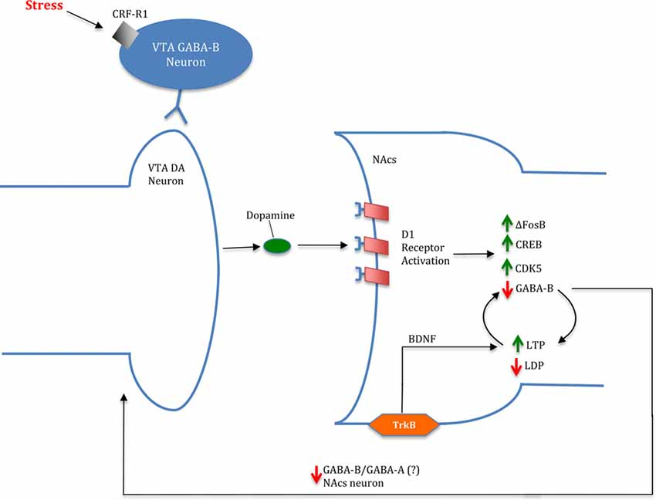
Changes in reward signaling pathway in the brain reward regions
Brain reward circuit mediate scratching-related itch relief
↓
AD upregulate DA release from VTA
↓
Increase DA D1 receptor activation
↓
Increase in ∆FosB, CREB and CDK5 levels in the Nac
↓
ΔFosB in brain reward circuits that in turn alters the phosphorylation levels of pDARPP32
↓
Decrease DA D1 receptor and dysregulation of DA signaling
↓
High levels of synaptic DA
↓
Decrease TH levels in VTA
Mukhara et al., 2018
TH - Rate-limiting enzyme in the production of dopamine

Slide 25
Changes in reward signaling pathway in the brain reward regions
CREB activity in the Nac
Elevations - anhedonia and depressive-like behavior
Reduced activity - promotes reward
Ability of the AD-like lesions to increase CREB phosphorylation
Elevated risk for depressive-like behavior
Elevations in BDNF levels in reward related brain areas
Anxiety and depressive-like behavior
Mukhara et al., 2018

Slide 26
Microglia - key player in neuroinflammation
Can influence neuronal plasticity
Through the secretion of cytokines
Shaping of neuronal network
Activated microglia in a stress condition
Start to produce pro-inflammatory cytokines
IL-1β, IL-6, and TNFα
Hypothalamus, Hippocampus, and Prefrontal Cortex (PFC) regions

Slide 27
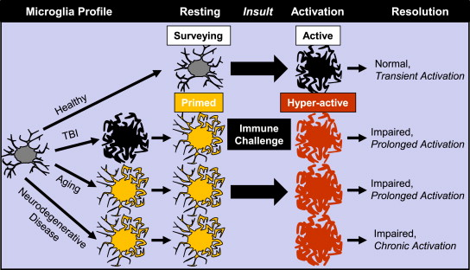
Primed Microglia & Increased Reactivity to Secondary Challenge
Microglia cannot only adapt to their circumstances but also memorize an initial activation - Priming State
↓
Leading to an exaggerated response to a second stimulation
Norden et al., 2015

Slide 28
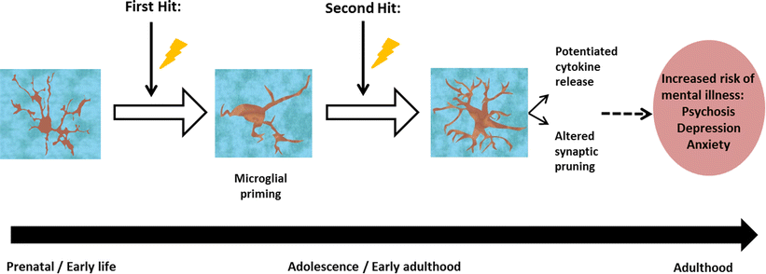
The ‘Two-hit’ hypothesis
Allergic Dermatitis
LPS Administration
Calcia et al., 2016

Slide 29
Experimental schedule for Oxazolone (Ox)-induced dermatitis in early life mice
1% Oxazolone (Ox) treatment on both ears every 2-3 day (total 10 times)
3% Ox sensitization
No behavioral abnormalities
No increase in pro-inflammatory cytokine expression
Observed primed state within the brain

Slide 30
Expression of microglial inhibitory marker, CD200R1, was more significantly downregulated in the amygdala of the Ox-treated mice compared to the control mice
Microglia might settle as the primed state in the brain of the Ox-treated mice on PD40
Notes:
Naïve – untrated group
Control – ethanol treated group
qRT-PCR

Slide 31
Expression of IL-6 in the hippocampus was significantly higher in the Ox-treated mice 4 h after LPS administration
Second insult with LPS administration caused potentiated
pro-inflammatory cytokine release
Notes:
qRT-PCR

Slide 32
Number of Iba-1 (a microglial activation marker)-positive cells was significantly increased in the hippocampus and amygdala of the Ox-treated mice 4 h after LPS administration
Second insult with LPS administration caused potentiated
microglial response
Notes:
qRT-PCR
There’s no difference between control and Ox - Hypothalamus

Slide 33
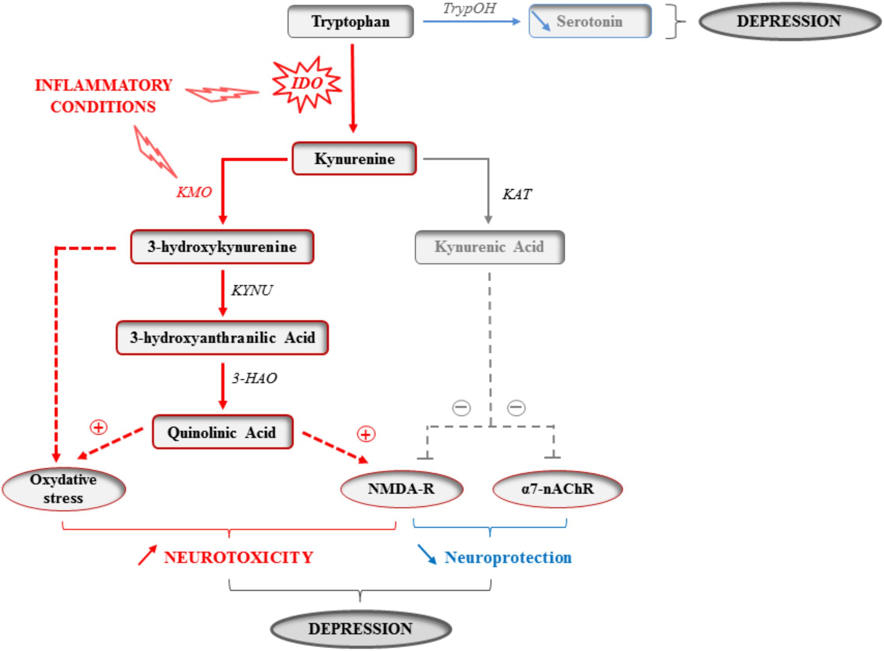
Kynurenine pathway (KP)
Leading to the production of NAD⁺, as well as other active metabolites
the degradation of tryptophan
An imbalance of tryptophan metabolism along the KP
influences depressive behavior in a systemic inflammatory condition
Key rate-limiting enzymes of the kynurenine metabolism pathway
Indoleamine 2,3-dioxygenase (IDO)
Kynurenine 3-monooxygenase (KMO)
Vancassel et al., 2018

Slide 34
IL-1β
IL-6
TNFα
Pro-inflammatory cytokines, IL-1β, IL-6, and TNFα, could induce IDO and KMO expression
IL-1β
IL-6
TNFα
Vancassel et al., 2018

Slide 35
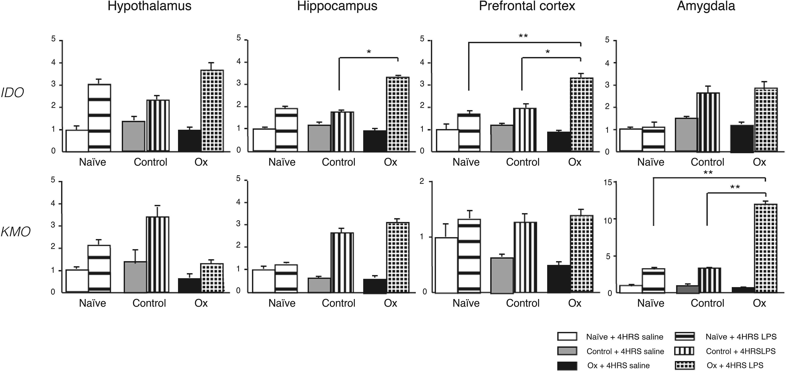
Increased expression of kynurenine metabolic key enzymes, indoleamine 2,3-dioxygenase (IDO) and kynurenine 3-monooxygenase (KMO), in Ox-treated mice 4 h after LPS administration
The kynurenine metabolism pathway – key pathway in inflammation-induced depression
Overproduction of pro-inflammatory cytokines caused abnormal tryptophan metabolism
Notes:
qRT-PCR

Slide 36
Depressive-like behavior was apparent 24 h after LPS challenge in the Ox-treated mice
Sucrose preference test (SPT)
The sucrose preference test – a reward-based test used as an indicator of anhedonia
Anhedonia – the decreased ability to experience pleasure
represents one of the core symptoms of depression
Reduced preference for sweet solution in SPT – represents anhedonia

Slide 37
Depressive-like behavior was apparent 24 h after LPS challenge in the Ox-treated mice
Tail suspension test
Ox-treated mice were more susceptible to systemic inflammation with LPS challenge

Slide 38
HIGHLIGHTS
Atopic Dermatitis - Early life
↓
Neuroinflammatory priming state
↓
Increased response for the neuroinflammation
↓
Overproduction of pro-inflammatory cytokines
↓
Abnormal tryptophan metabolism
↓
Depressive-like behaviors

Slide 39
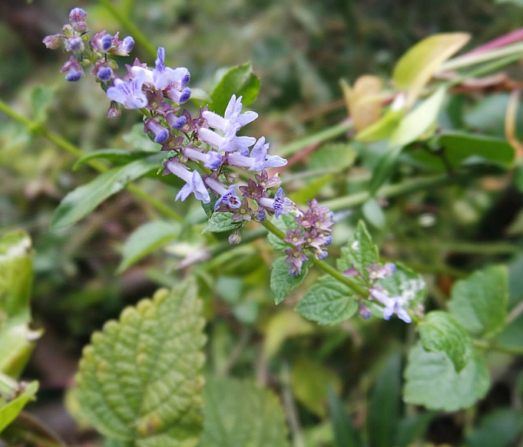
Isodon inflexus extract (IIE)
Widely utilized in Korea, China, and Japan for medicinal purpose
Treat gastrointestinal disorders, tumors, and various inflammatory disease
Important components
Rosmarinic acid (RosA)
Chlorogenic acid (CGA)
http://wildplantsshimane.jp/Plates/Isodon_umbrosus.html

Slide 40
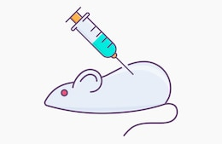
Experimental groups for investigating the effects of IIE on depressive behavior in AD mice
Normal – untreated
Dermatophagoides farinae extract (DfE)-induced AD mice – untreated
Dfe-induced AD mice – 1 % IIE treated
Dfe-induced AD mice – 3 % IIE treated
Dfe-induced AD mice – tacrolimus treated - Positive control
https://www.shutterstock.com/search/injection+in+mouse
Notes:
Tacrolimus - topical medication in the treatment for allergies.

Slide 41
Effect of IIE on the development of AD
IIE treatment significantly reduced skin damage

Slide 42
Effect of IIE on Anxiety-like behavior
Open field test (OFT)
IIE treatment significantly reduced anxiety-like behavior

Slide 43
Effect of IIE on depressive-like behavior
Sucrose preference test (SPT)
IIE treatment significantly reduced depressive-like behavior

Slide 44
Effect of IIE on levels of IgE and histamine

Slide 45
Effect of IIE on mast cell accumulation
Notes:
Dorsal skin
Ear tissue

Slide 46
Effect of IIE on depression-related hormone
IIE treatment significantly reduced levels of stress- and depression-related corticosterone hormone

Slide 47
Effect of IIE on microglia and macrophage activation
CA1 | CA2 | CA3

Slide 48
Effect of IIE on neuroinflammatory response
IIE treatment significantly reduced pro-inflammatory cytokine TNFα levels
Notes:
Western blot

Slide 49
HIGHLIGHTS
MC903-induced AD-like skin lesions triggers anxiety- and depressive-like behaviors
MC903-induced AD alters neuronal plasticity and DA-related molecules in the mesolimbic system

Slide 50
HIGHLIGHTS
Early-life dermatitis causes neuroinflammatory priming in later life
The number of activated microglia is increased after an additional insult
Additional systemic inflammation induces depressive-like behaviors
Second insult causes abnormal kynurenine metabolism within the brain

Slide 51
HIGHLIGHTS
IIE treatment alleviated not only the AD symptoms but the depressive-like behaviors as well

Slide 52
So what’s next? – New Problems
Does sex difference affect development of anxiety- and depressive- like behavior with AD ?
Does sex difference affect early life stress with allergic dermatitis on mental health in adolescent life?

Slide 53
Conclusion – Take Home Messages
Development of AD-like skin lesions in adult mice leads to anxiety- and depressive-like behaviors, which may be associated with neuronal adaptation in reward-related brain regions
Early life stress from AD aggravates susceptibility to systemic inflammation in the adolescent mice brains, leading to depressive behaviors with abnormal kynurenine metabolism
IIE is a candidate anti-AD therapy due to its ability to exert neuroprotective and antidepressant effects

